Slide 1

Graphic & Web Development

Slide 2

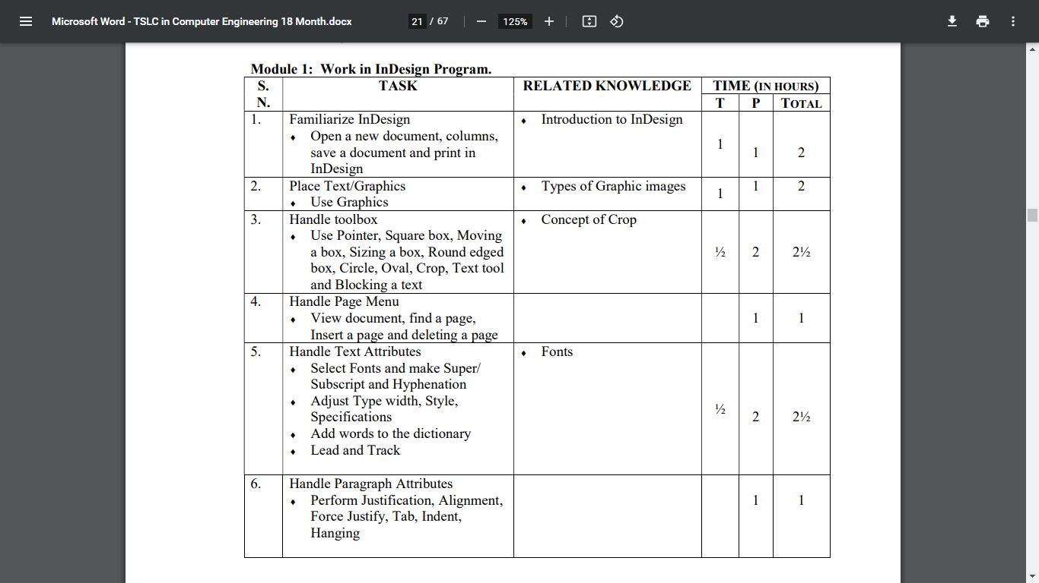
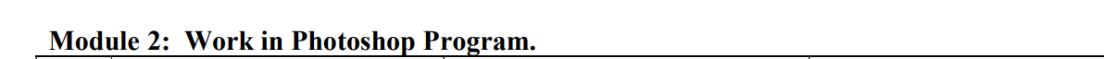

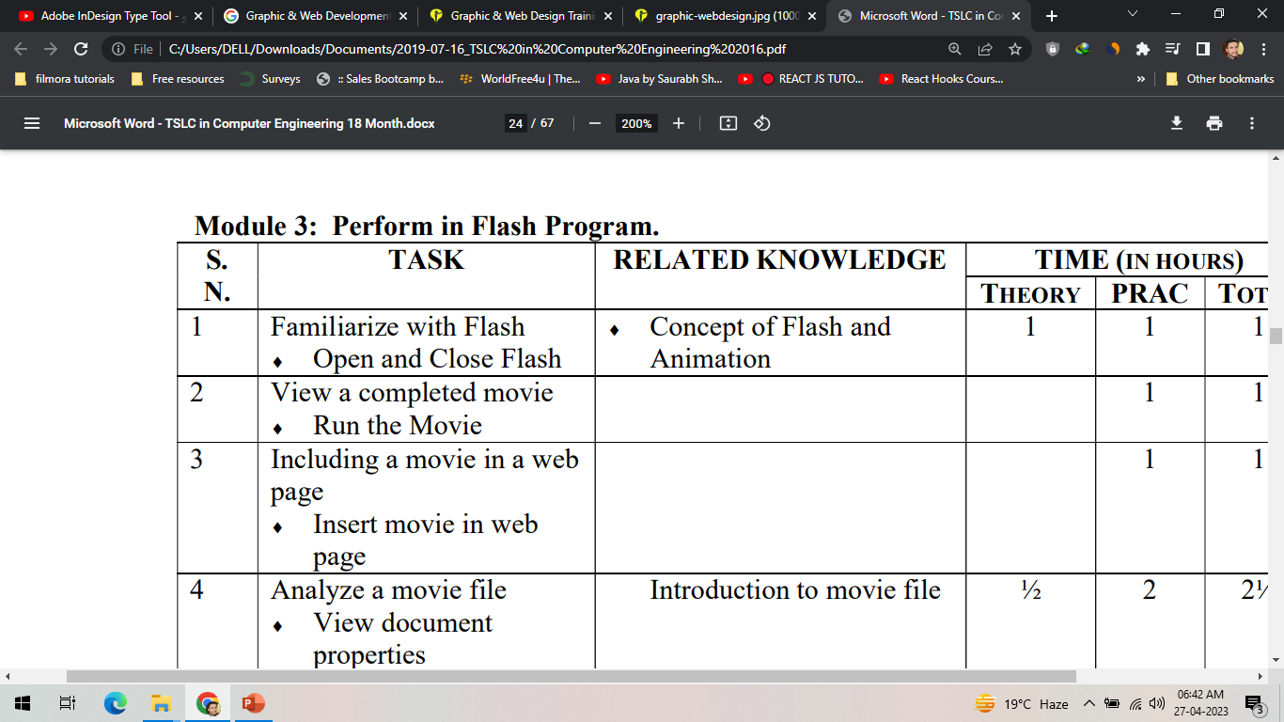
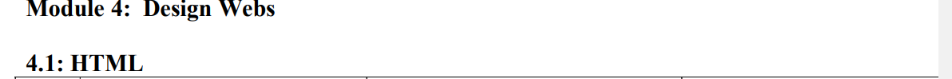
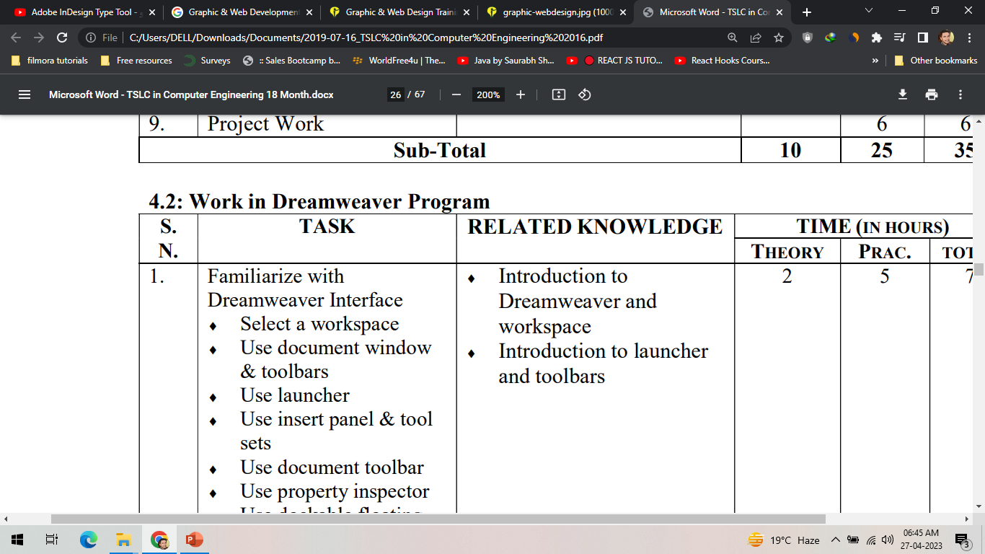

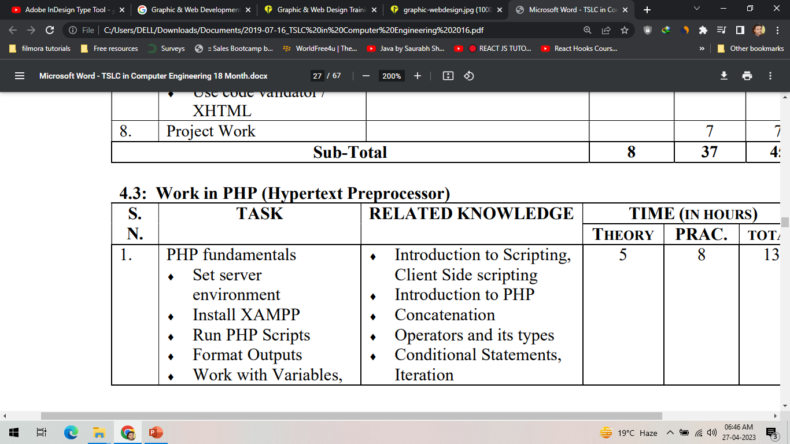
Syllabus

Slide 3

Adobe InDesign

Slide 4
What is Adobe InDesign?
The main purpose of Adobe InDesign is Layout Design
Master of Handling the Huge Text Design
Create and publish books, digital magazines, eBooks, posters, and interactive PDFs with InDesign

